Slide 1
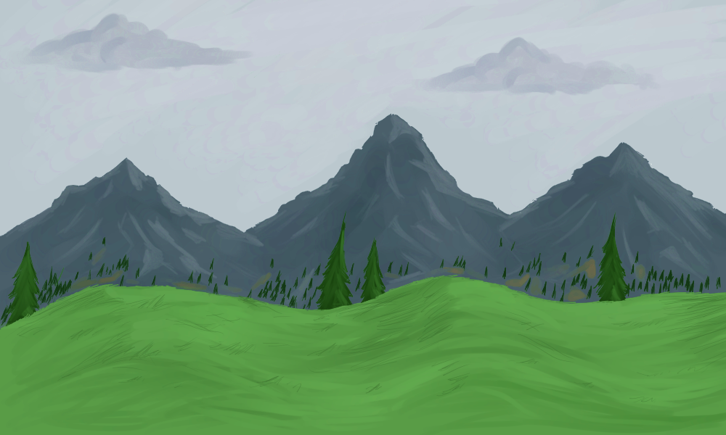




Observer no. 1, ready?
Start time: 9:00 am

Slide 2
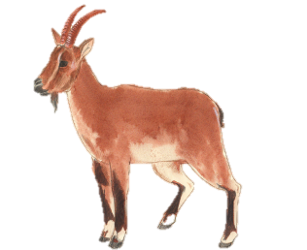
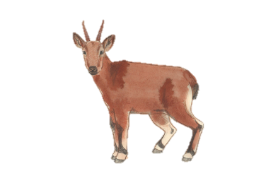
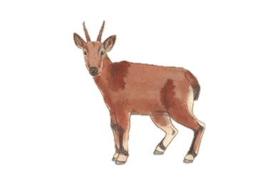
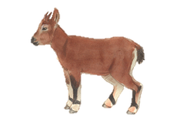

Observation no. 1
Time: 9:20 am
Location: Right-side top 1st Ridge

Slide 3
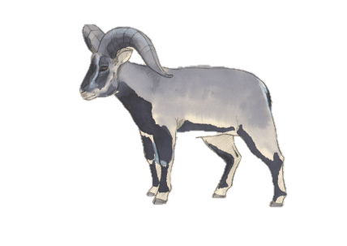
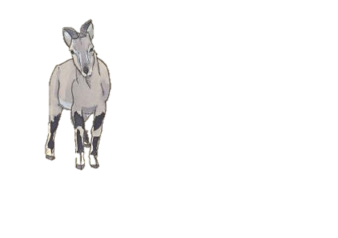
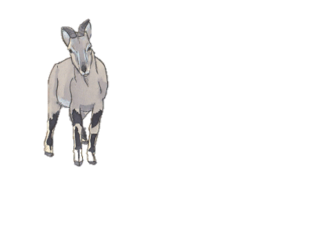

Observation no. 2
Time: 9:24 am
Location: Right-side top 1st Ridge

Slide 4
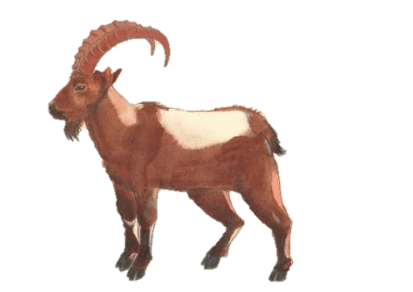
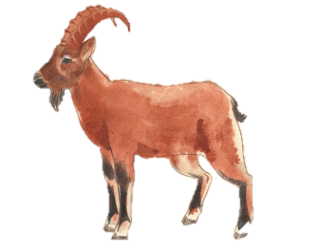
Observation no. 3
Time: 9:42 am
Location: Left-side top 2nd Ridge

Slide 5
Observation no. 4
Time: 10:06 am
Location: Left-side bottom 2nd Ridge

Slide 6
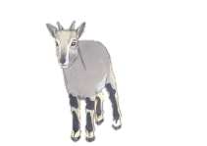
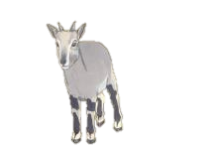
Observation no. 5
Time: 10:10 am
Location: Left-side middle 2nd Ridge

Slide 7
Observation no. 6
Time: 10:48 am
Location: Right-side middle 3rd Ridge

Slide 8
Observation no. 7
Time: 10:59 am
Location: Right-side top 3rd Ridge

Slide 9
Observation no. 8
Time: 11:43 am
Location: Left-side bottom 4th Ridge

Slide 10
Observation no. 9
Time: 12:01 pm
Location: Left-side middle 6th Ridge

Slide 11
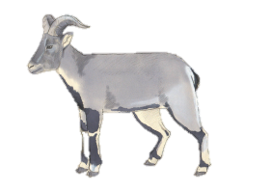
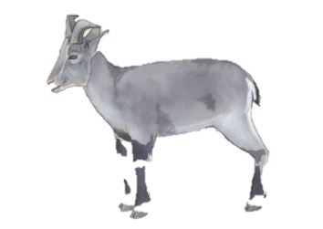
Observation no. 10
Time: 12:09 pm
Location: Left-side bottom 8th Ridge

Slide 12
Observation no. 11
Time: 1:14 pm
Location: Left-side top 9th Ridge

Slide 13
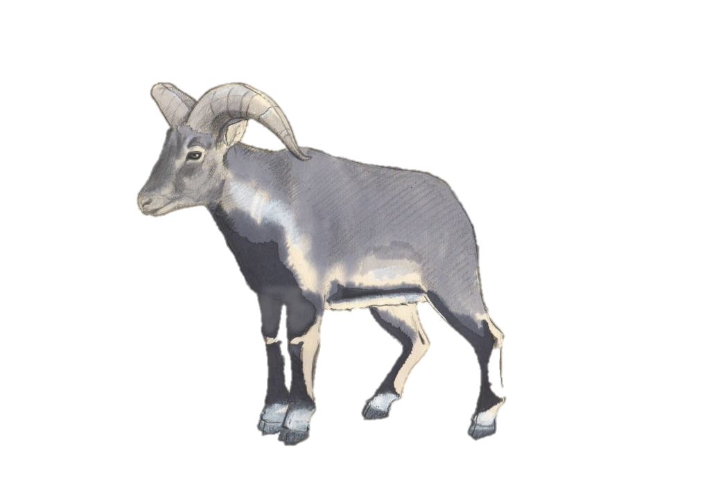
Observation no. 12
Time: 2:09 pm
Location: Left-side top12th Ridge

Slide 14
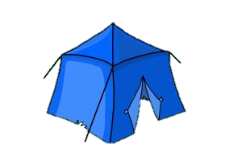
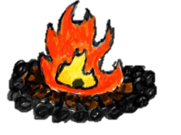
Observer 1, end
End time: 2:15 pm
Location: Ridge 12

